Slide 1
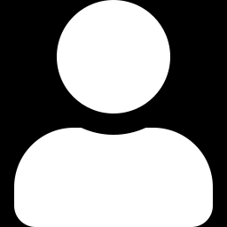
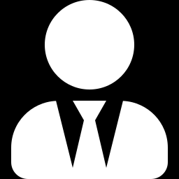
What happens if you whisper a rumor to 100 AI investors?
Psst… bad news!
TwinMarket: A Scalable Behavioral and Social Simulation for Financial Markets
Yang, Zhang, Wu et al. · CUHK-Shenzhen & Nanjing University
NeurIPS 2025
Best Paper · ICLR 2025 Financial AI Workshop
李婧雅 Jingya Li

Slide 2
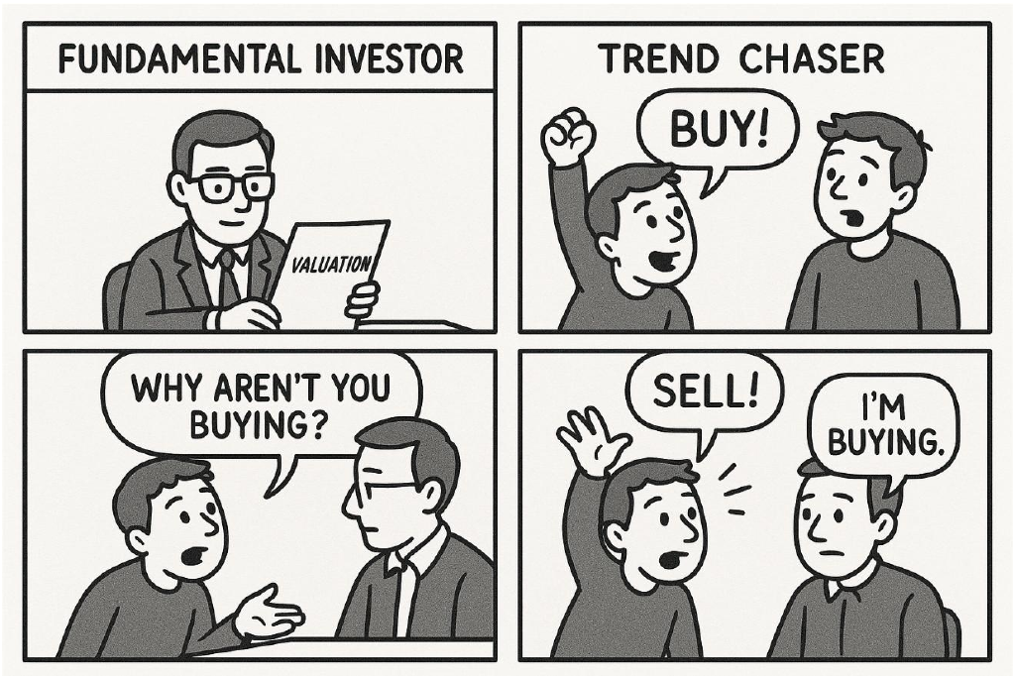
Markets are moved by people
Traditional models
Identical agents
Fixed, simple rules
No social media
Real investors
Emotions & biases
Follow the crowd
Read each other's posts
vs
Research question: Can AI agents act like real investors, and recreate how real markets behave?
Different investors, different minds

Slide 3
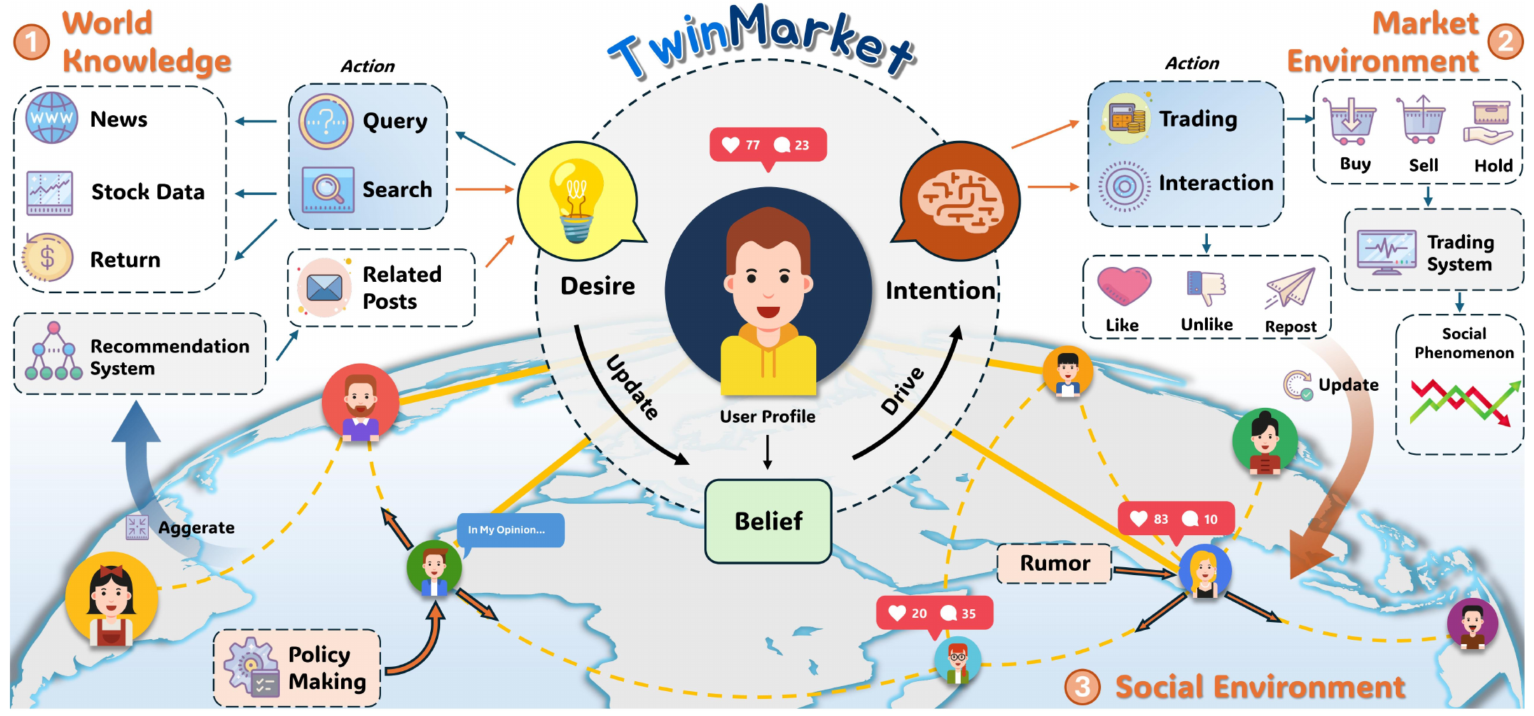



TwinMarket: AI investors living on a social network
Real people as templates
639 real investors from Xueqiu set each agent's style and biases
Believe → Want → Act
Each day: form a view, search news & posts, then trade
A living social network
Similar traders see each other's posts; daily auction matches trades
Daily loop: read news & posts → search for more → update belief → trade → post → market updates
100 GPT-4o agents
5 months simulated trading
1,000 agents when scaled up

Slide 4
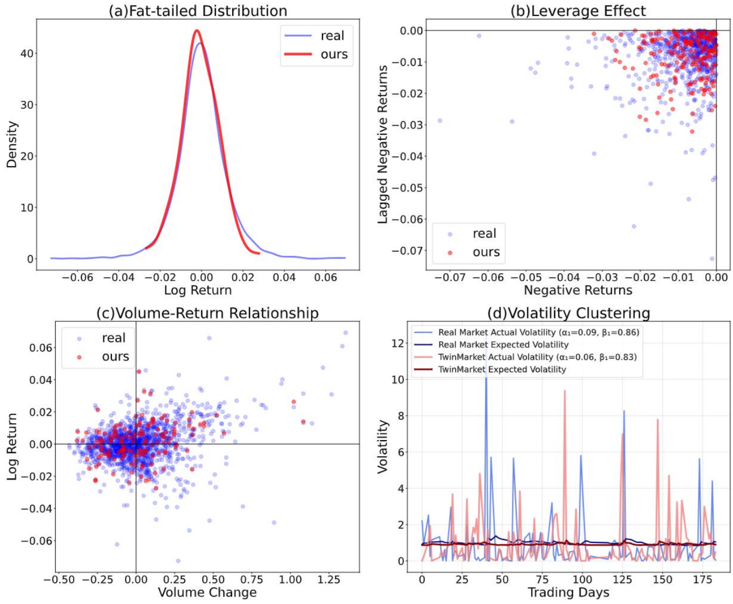
The simulated market behaves like the real one
All 4 classic market patterns reproduced
Market pattern | Real | TwinMarket
Extreme moves (kurtosis) | 7.26 | 5.24
Volatility clustering | 0.95 | 0.89
Leverage effect | 0.14 | 0.11
AI investors overtrade and lose, just like humans
+6.65%
−10.52%
Top 10%
trade less
(turnover 4.02%)
Bottom 50%
trade more
(turnover 7.03%)
Red = TwinMarket Blue = real market

Slide 5
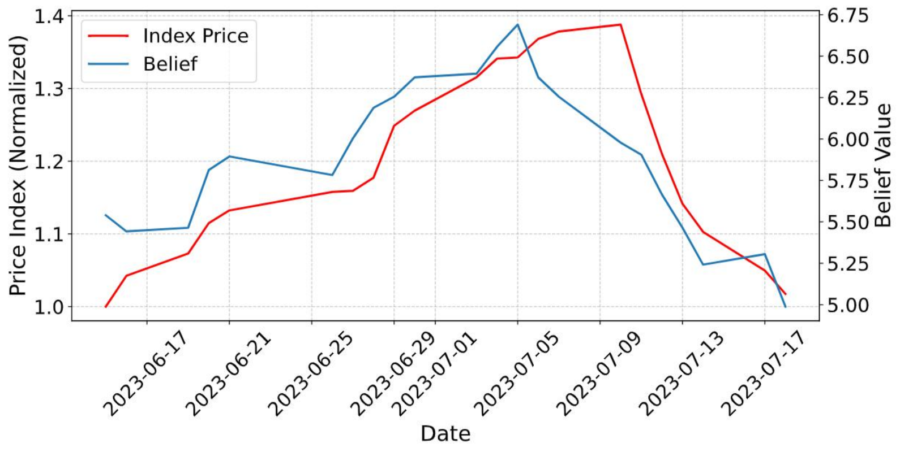
Bubbles form and burst on their own
2
1
Optimism feeds itself
Good mood → buying → higher prices → even better mood
1
3
2
Belief peaks first
Confidence turns around Jul 5, while prices keep climbing
3
The crash
Prices follow belief down from Jul 10, wiping out the gains
Blue = average AI investor belief Red = price index
Nobody programmed a bubble. It emerged from the agents.

Slide 6
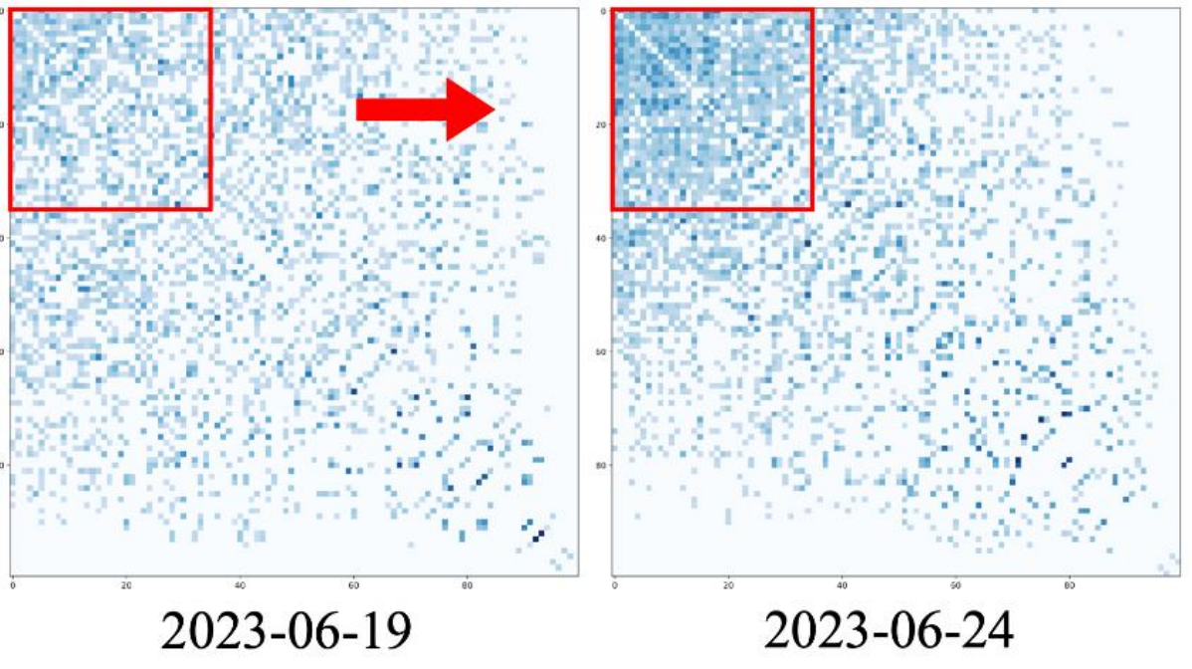
One rumor, and the market panics
Experiment: inject a fake negative rumor into the social network
−27.5%
lower valuation by agents who saw the rumor
0.50 → 1.00
sell-to-buy ratio nearly doubles, and prices fall
Investors who think alike cluster tighter after the rumor: an echo chamber
No crash was programmed. Panic spread through reading, posting and copying.

Slide 7

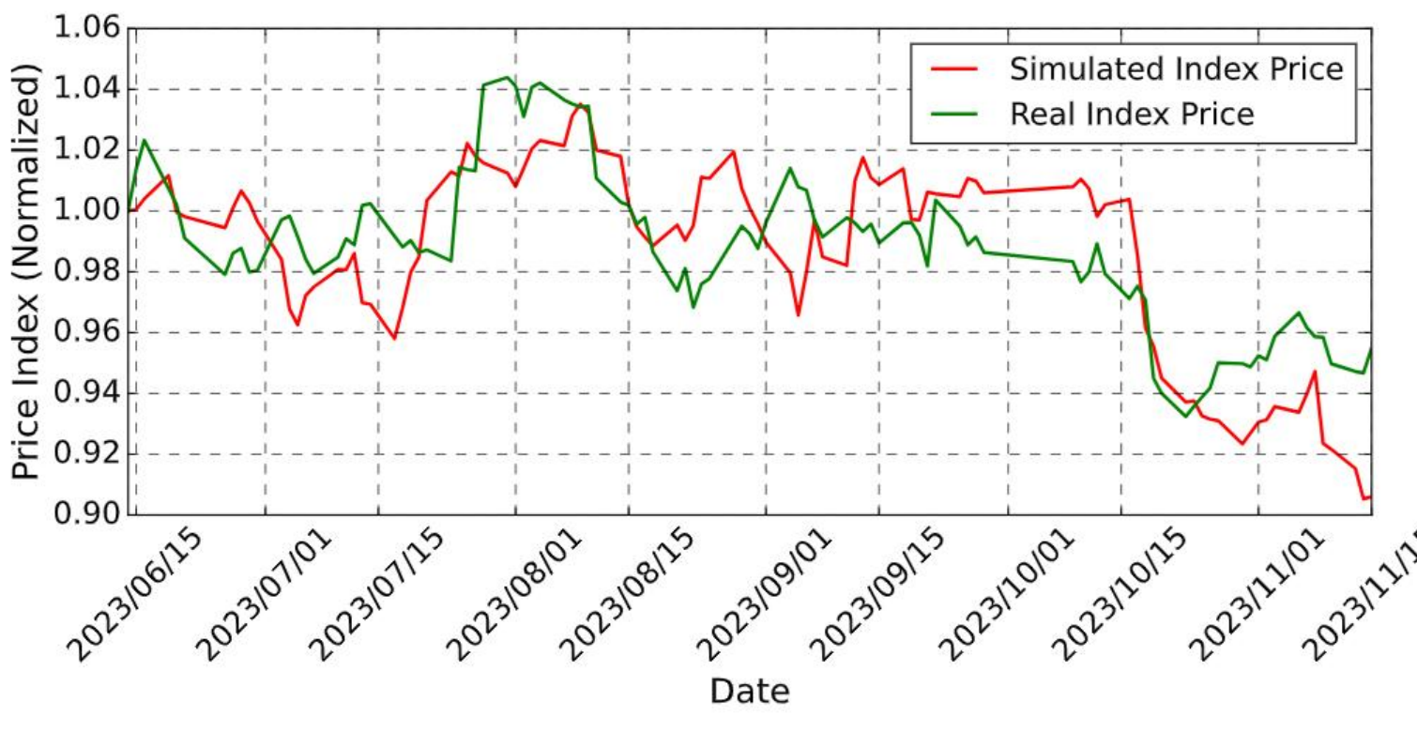


TwinMarket: a wind tunnel for financial markets
Test before it's real
Try rumors, policies and regulations on AI investors first
Crowds from individuals
Bubbles, panics and echo chambers emerge from 1,000 interacting agents
Limits
China A-shares only · one auction per day · AI agents ≠ real humans
1,000-agent simulation vs real index
Thank you!

Slide 8
Backup: what if every investor were identical?
Variant | Corr. ↑ | Kurtosis ↑ | RMSE ↓
Full TwinMarket | 0.77 | 5.24 | 0.02
Without BDI | 0.34 | 4.25 | 0.07
All identical | −0.61 | 3.58 | 0.09
Diversity is the secret ingredient
Make every investor the same and the simulated market moves opposite to the real one.
Notes:
Use only if asked how we know the agents are realistic. Removing the BDI loop or making all agents identical makes the simulation much worse; with identical agents, the simulated price even moves opposite to the real market (correlation −0.61 instead of +0.77).

